Slide 1
Environmental, Social, and Governance (ESG) and you!
Can you invest on stocks based on their sustainability ratings?

Slide 2
Table of Contents
Overview
Project objective
Deliverables
ESG Trends
Data Exploration
Vision
Data Source
Analysis
References
Questions to answer
Tools used in the project
Team

Slide 3

Overview
Here at ESG Consultants, we are building a machine learning module to
Help you in ESG investing.
Figure out if ESG scores have any relation to investor’s confidence.

Slide 4
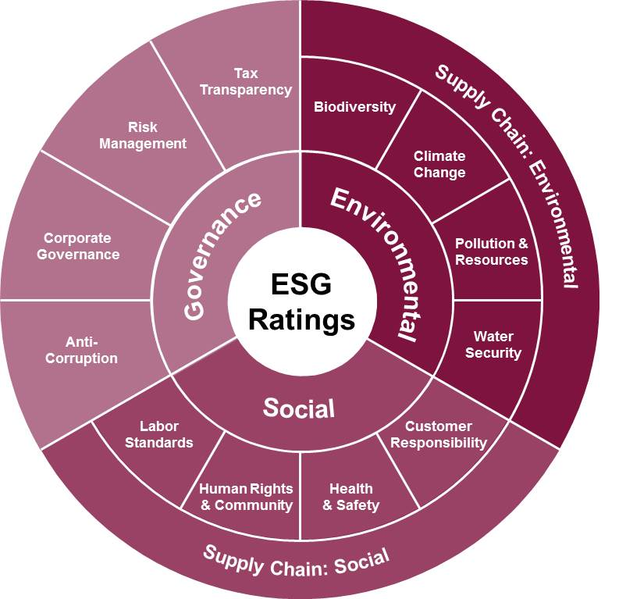
What is ESG and why is it important?
Our dashboard is directed at financial investors who are looking to build their portfolio with sustainability in mind.

Slide 5
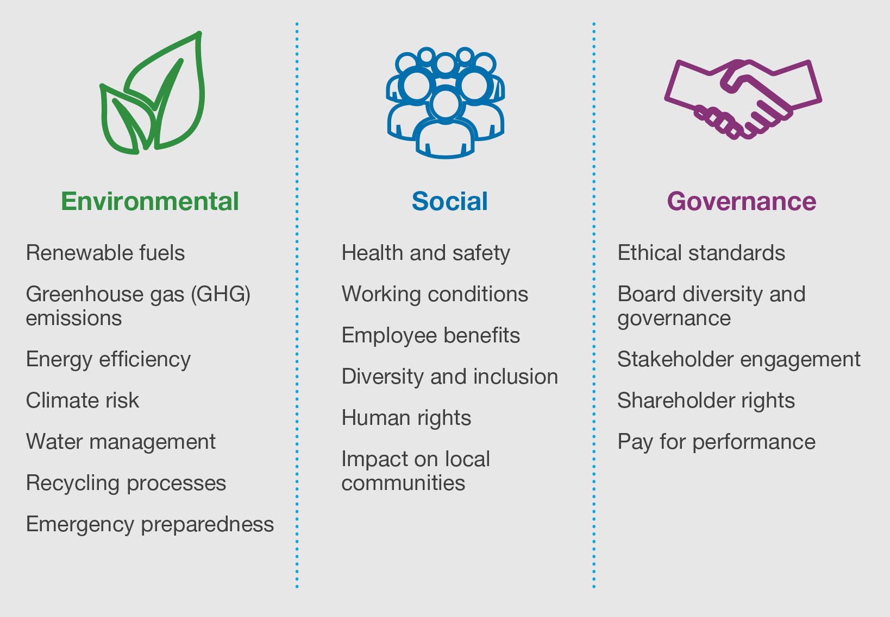
ESG Trends
01
Environment (E): 56% of population lives in cities and towns and account for 70% of CO₂ emissions by 2050 70% will live in towns and cities. The global temperature will rise by 1.5◦ C if we have Net Zero Emissions of CO2 by 2050 otherwise may be more than 3.5◦ C.
Notes:
We wan to know whether about the company’s energy use , waste, pollution, natural resource conservation, treatment of animals etc.

Slide 6
ESG Trends
02
Social (S): The global population is 8 billion set to rise to 8.5 billion by 2030 and 9.7 billion by 2050. Community Relations, Human Rights, Workplace Health and Safety, Diversity and Inclusion are the pillars for human dignity and quality of life.
Notes:
We want to know company’s does a company donate a portion to local communities , and all points mentioned above in grey.

Slide 7
ESG Trends
03
Governance(G): With a population of more than 8.5 billion and global temperatures rising the need for innovation in Policy and Code of Conduct, Supply Chain Management, is the only way to sustain healthy economic growth
Notes:
Company uses accurate and transparent accounting methods, stockholder’s allowed to vote on important issues and all mentioned in grey above.

Slide 8
The Data Source
We chose Forbes’ Just 100 list of ESG stocks for investing and extracted data from Yahoo! Finance.
Sustainability parameters as well as company performance numbers like ROE, ROA, revenue for 55 companies.
Five years of historical stock price data to predict the stock prices using machine learning.

Slide 9
Questions that we hope to answer ?
Do high ESG scores affect the companies bottom line?
Which industries have high ESG scores?
1
3
What are the red flags that effect ESG ratings?
4
How can help you in ESG investing
2
Is there a correlation between stock market performance and ESG ratings?
5

Slide 10
Project objective
Transform publicly available data from Yahoo! Finance into a database for analysis.
Build a machine learning module to evaluate performance
Visualize the results in order to make predictions and draw conclusions.

Slide 11



Data Exploration
Feature Engineering
Train/Test Sets -Set Model Parameters
Data Preprocessing
01
Identify features for optimal performance.
Perform transformations.
03
02
Remove/Replace null data .
Ensure the data type is correct.
Remove unwanted fields
Train/test/Scale data for regression
Chose model parameters for fbprophet
Notes:
Remove null data by zero or Not Applicable, or the correct data has been supplied.
Ensure that all fields like date, floating numbers etc. have correct data types
Out of all similar fields, one has been kept other removed.
The field names have been changed to so that they have better meaning and converted to camel casing for database.

Slide 12

Analysis

Slide 13
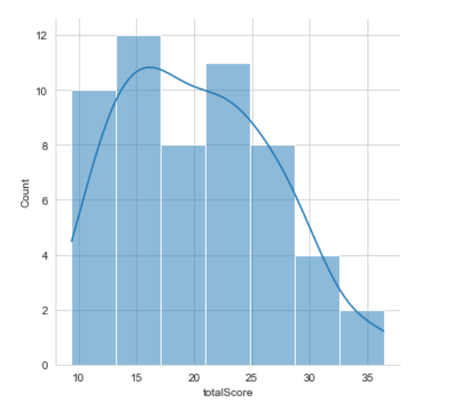
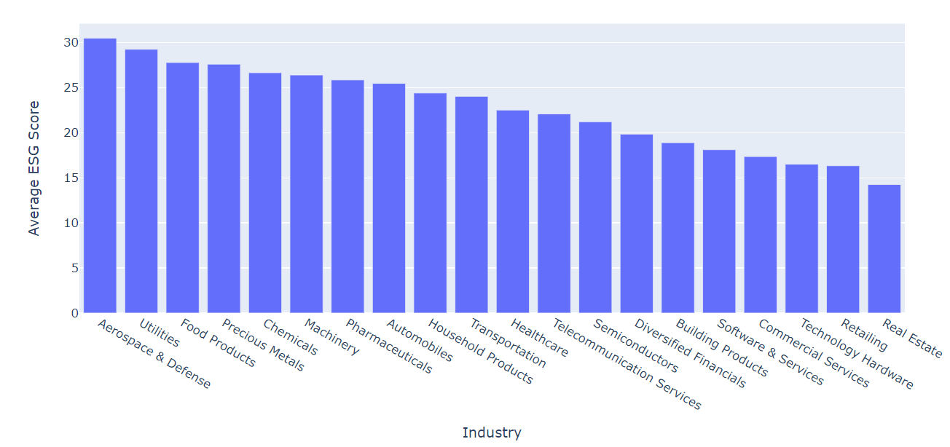
ESG scores distribution

Slide 14
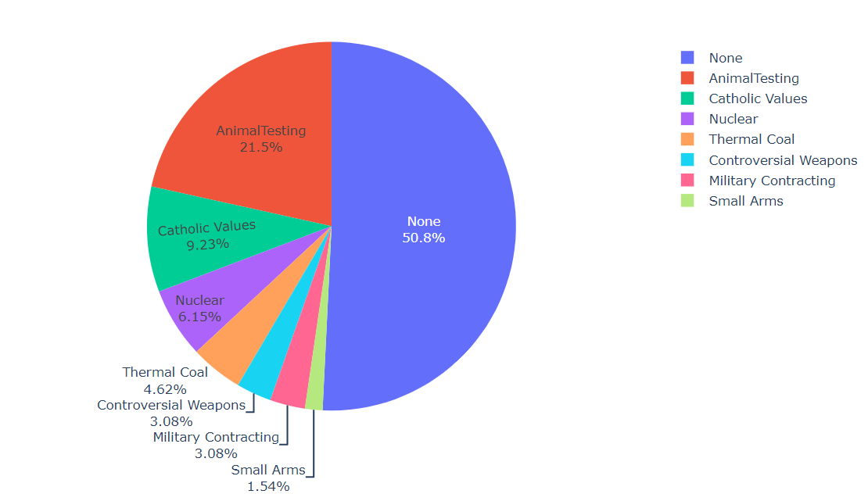
Red flags in business values for companies

Slide 15
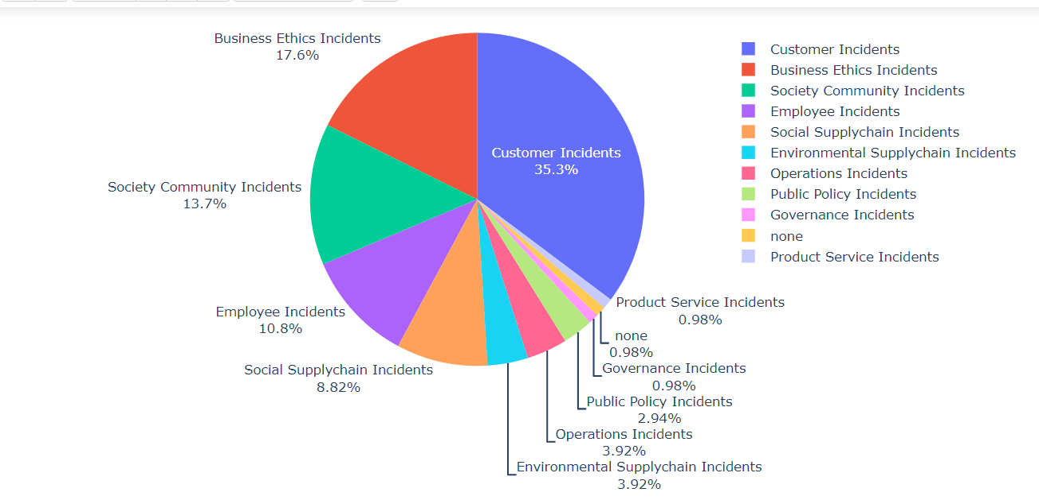
Red flags for controversies in companies

Slide 16
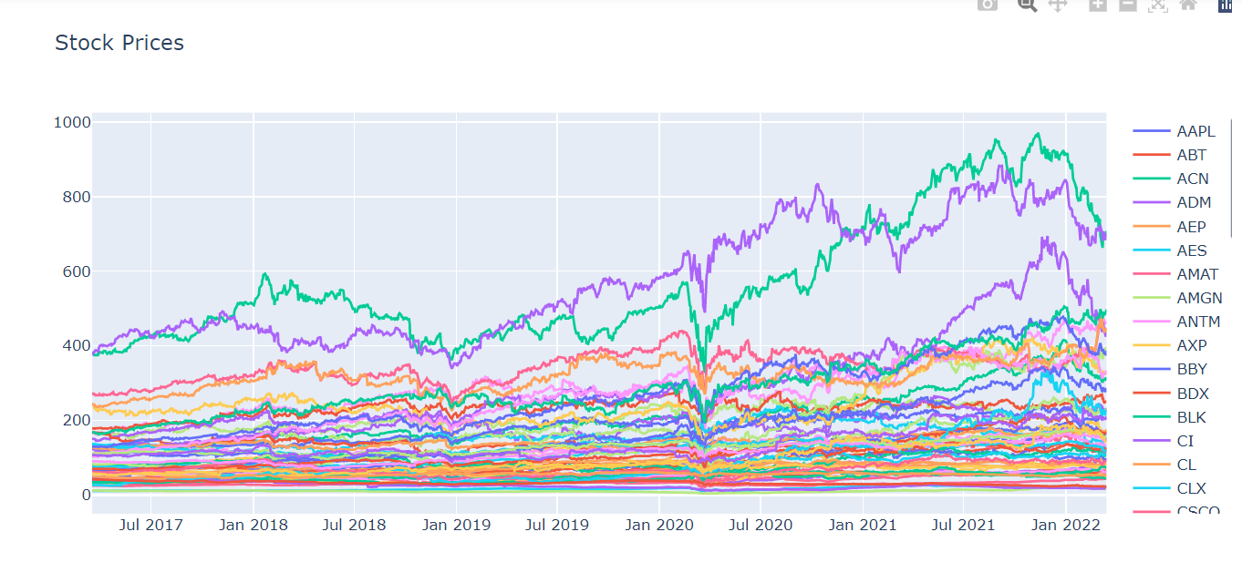
Stocks prices line plot

Slide 17
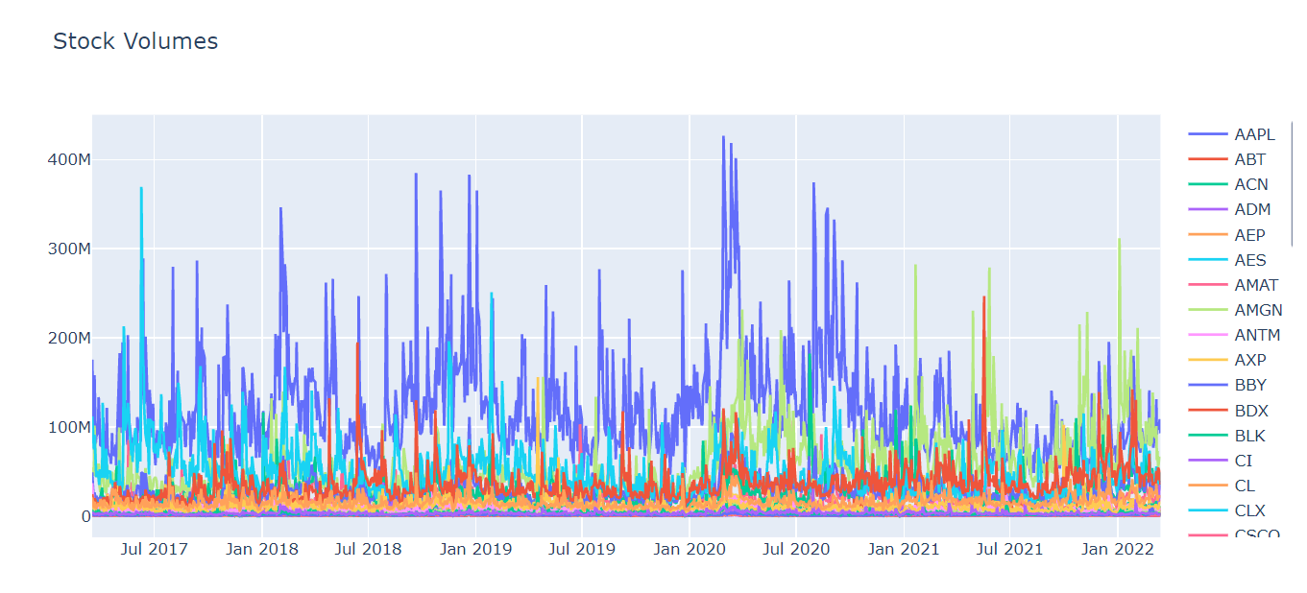
Stocks Volume line plot

Slide 18
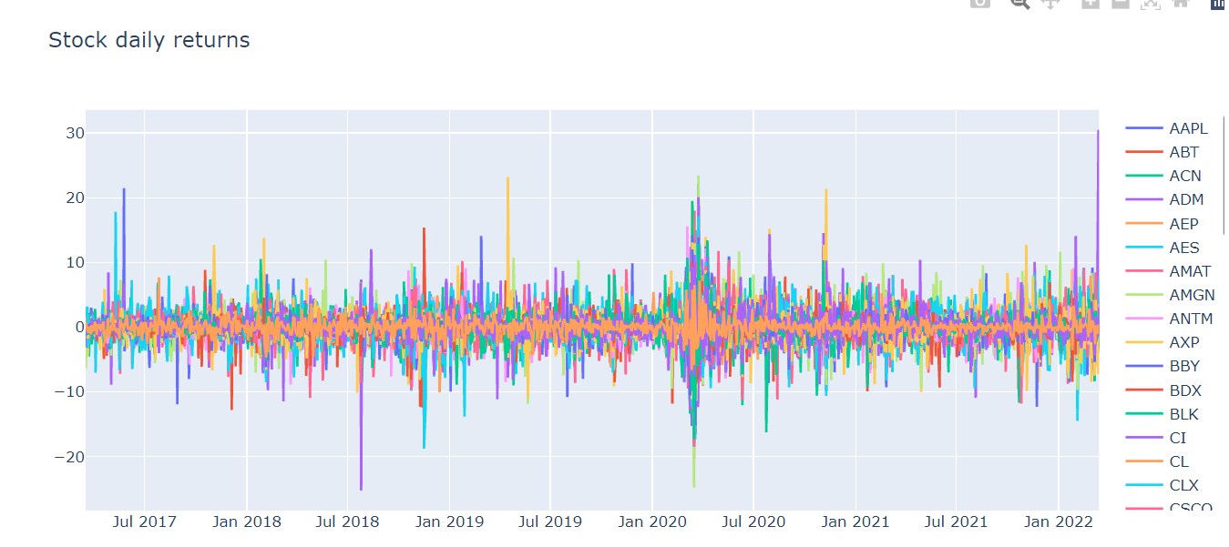
Stocks daily returns

Slide 19
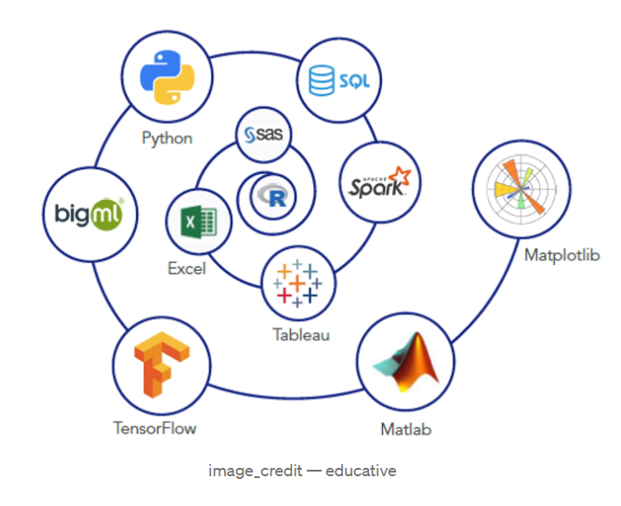
Primary tools used in the project
Python and libraries like pandas, numpy, plotly, seaborn for EDA.
Finance API’s like yfinance and yesg for data extraction.
fbprophet and sklearn for machine learning
AWS RDS Postgres, sqlalchemy for database connection
Tableau for visualization

Slide 20

Deliverables

Slide 21
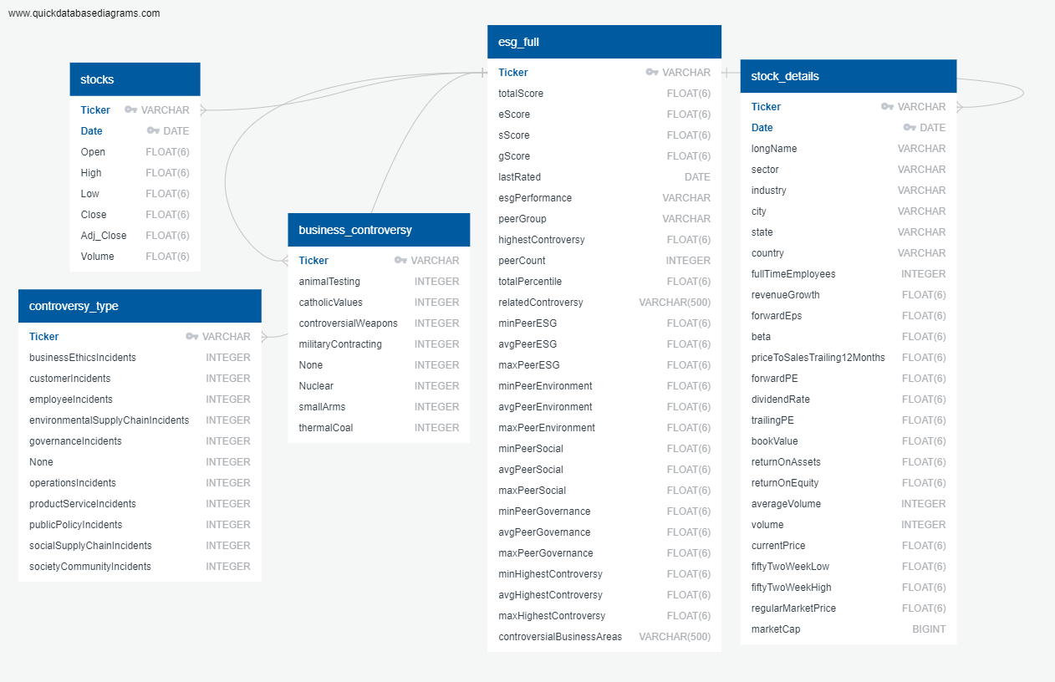
Database
Framework
Our Database contains:
stocks
controversy_type
business_controversy
esg_full
stock_details

Slide 22
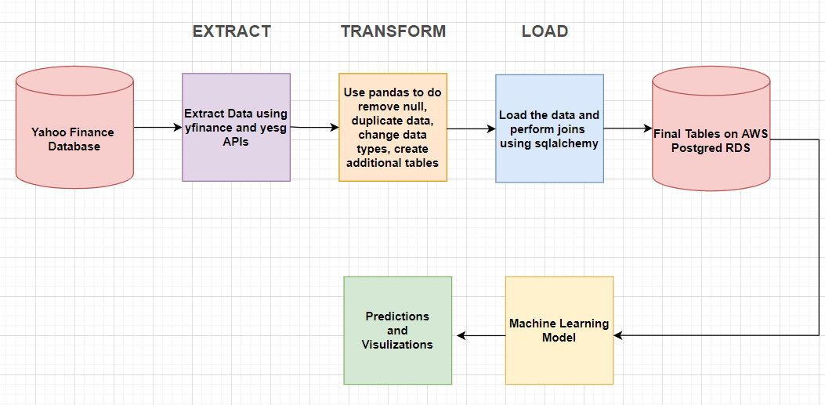
ETL Pipeline

Slide 23
Machine Learning for Stock prediction
Our first model was linear regression which could not predict stocks beyond a few days due to trends and non-linearity, so finally fbprophet was chosen
Benefits:
It does not require much prior knowledge of forecasting time series data
Based on an additive model where non-linear trends are fit with yearly, weekly, and daily seasonality, plus holiday effects.
Prophet is robust to missing data and shifts in the trend, and typically handles outliers well.
Limitations:
Prophet is generally recommended only for time series where the only informative signals are trends, and the residuals are just noise.
There are other models like ARIMA can consistenly outperform Prophet when trends are not too important.
Notes:
Stock predictions are based on time series models (with linear regression)
Try out ARIMA
Try out facebook prophet
Limitations: weekends/holidays effect

Slide 24
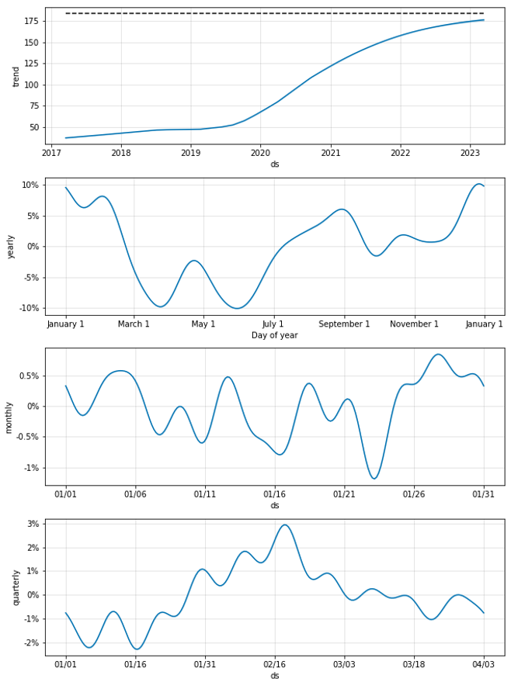
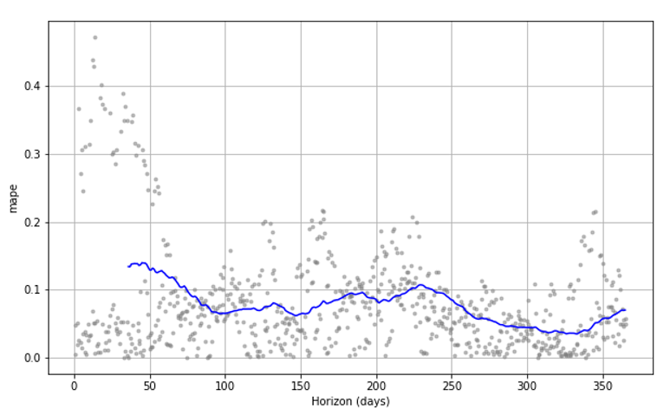
Apple - Forecast for AAPL stock Apple - Mean absolute percentage error(MAPE)

Slide 25
Machine Learning for ESG and stock price correlation
Our linear regression model compares ESG to stock prices
Benefits:
All the companies can use this method because sales are always positive. In the dividend method, if the current year dividend is Zero, we cannot use it.
No human intervention is needed (automation)
It shows a positive relationship between the value of Stock Price increase from investor confidence and ESG Score.
Limitations:
This method is for comparable companies(industry). We need to make sure all the companies in the same industry must have a similar size. ex: Sobey and Walmart are supermarkets, but one is national, and another is global
The p-value is 0.34, which is higher than 0.05. We cannot use this model to measure how many prices of ESG influences the stock price, but it shows us ESG has a positive relationship with the stock price.
Our model only uses 2022 information, which can show you a short-term relationship. If we can add past year information, it will establish an exact relationship.
Notes:
Stock predictions are based on time series models (with linear regression)
Try out ARIMA
Try out facebook prophet
Limitations: weekends/holidays effect

Slide 26
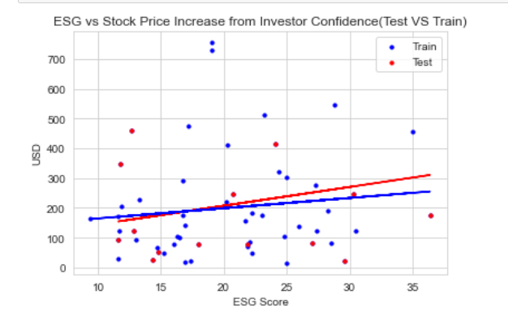
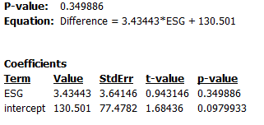
ESG vs Stock Price
Improvements: More Data, Increasing Scope and Time. In this model, we use 55 companies, that are not enough, and we only get the 2022 ESG score because the old information is not for the public.
P-value: 0.349886
Equation: Difference = 3.4344*ESG + 13.501

Slide 27
The Dashboard
Why Tableau?
Tableau offers integration with our database increasing longevity and reusability
Tableau provides clean and easy ways to visualize our data
Storyboards allow our users to interact with our dashboard to drill down and learn more

Slide 28
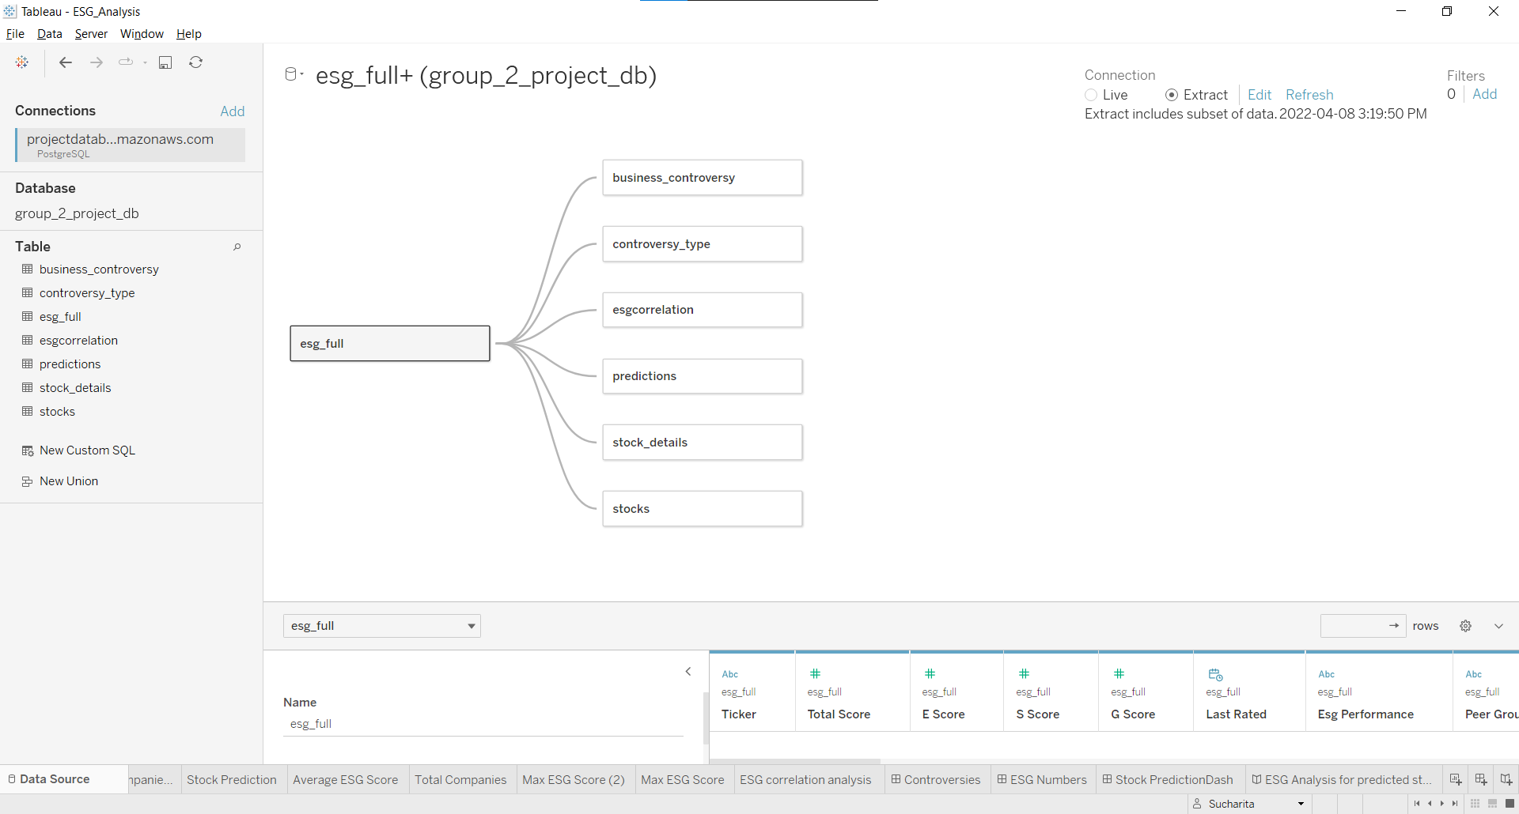
Tableau Data Source

Slide 29
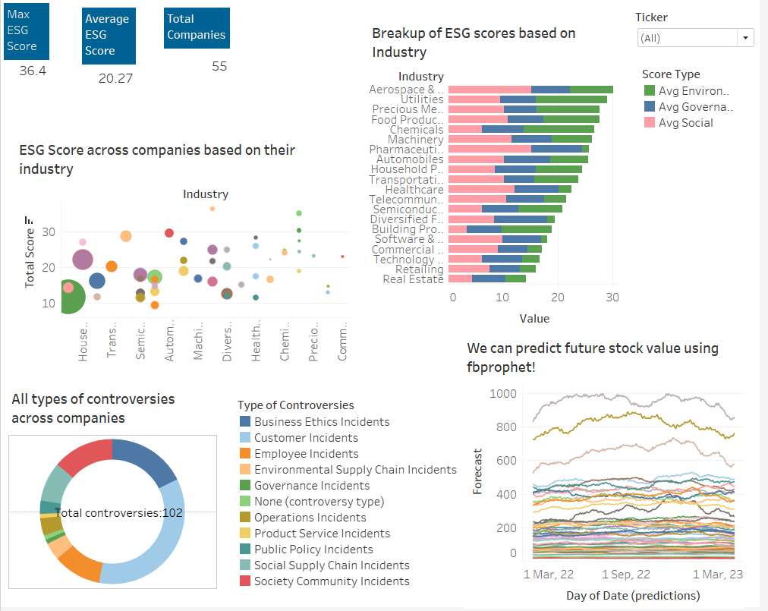
Interactive Element

Slide 30
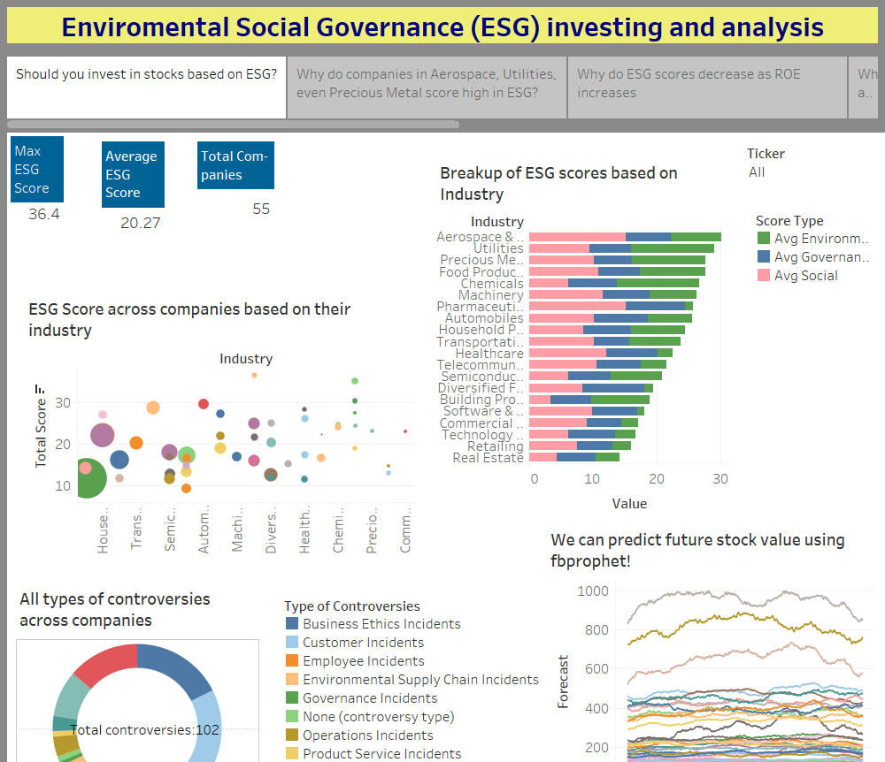

Slide 31
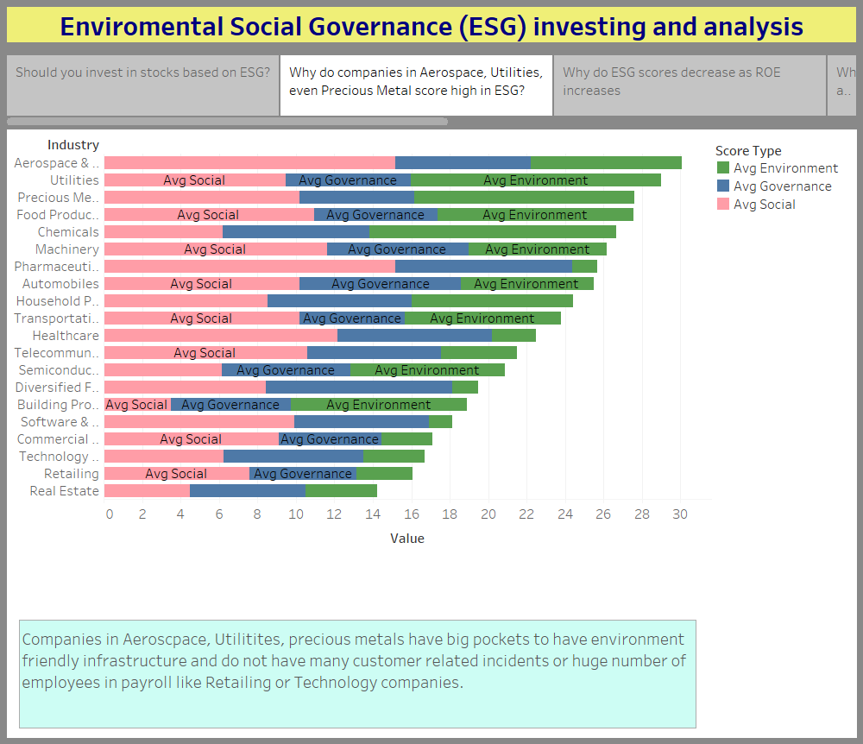

Slide 32
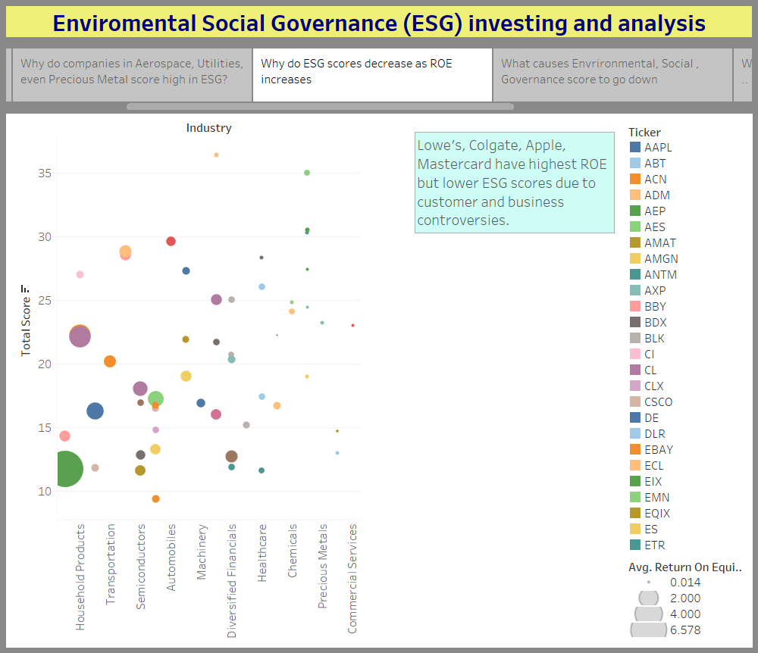

Slide 33
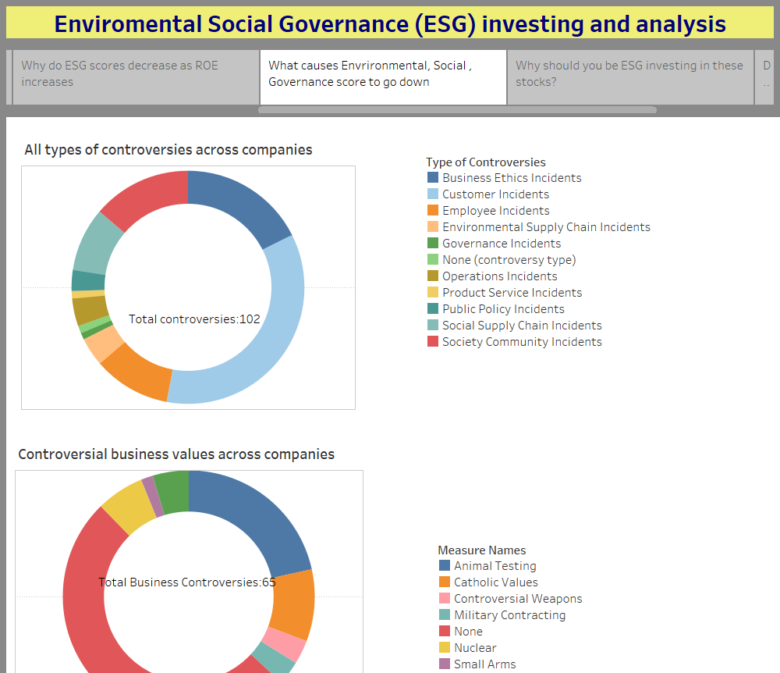

Slide 34
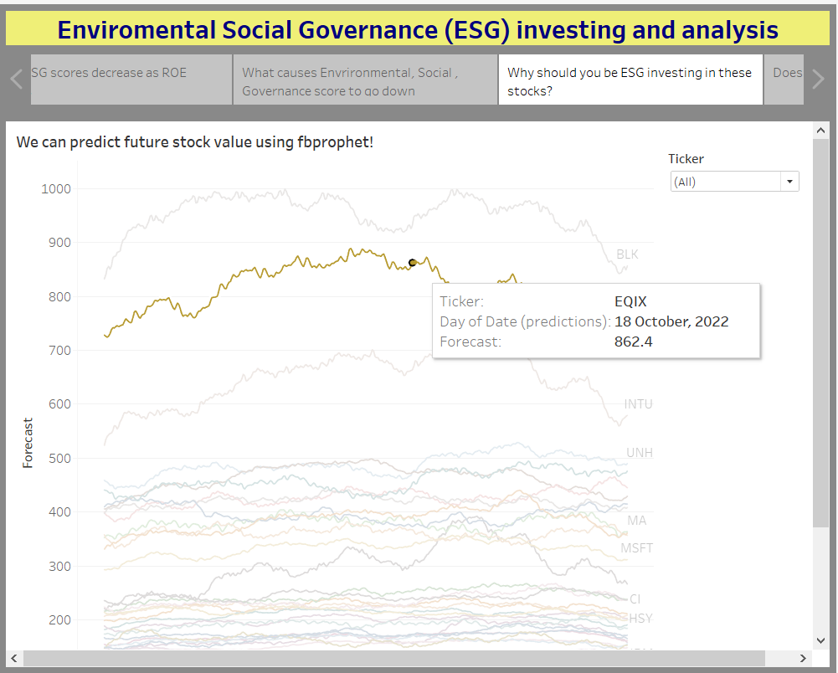

Slide 35
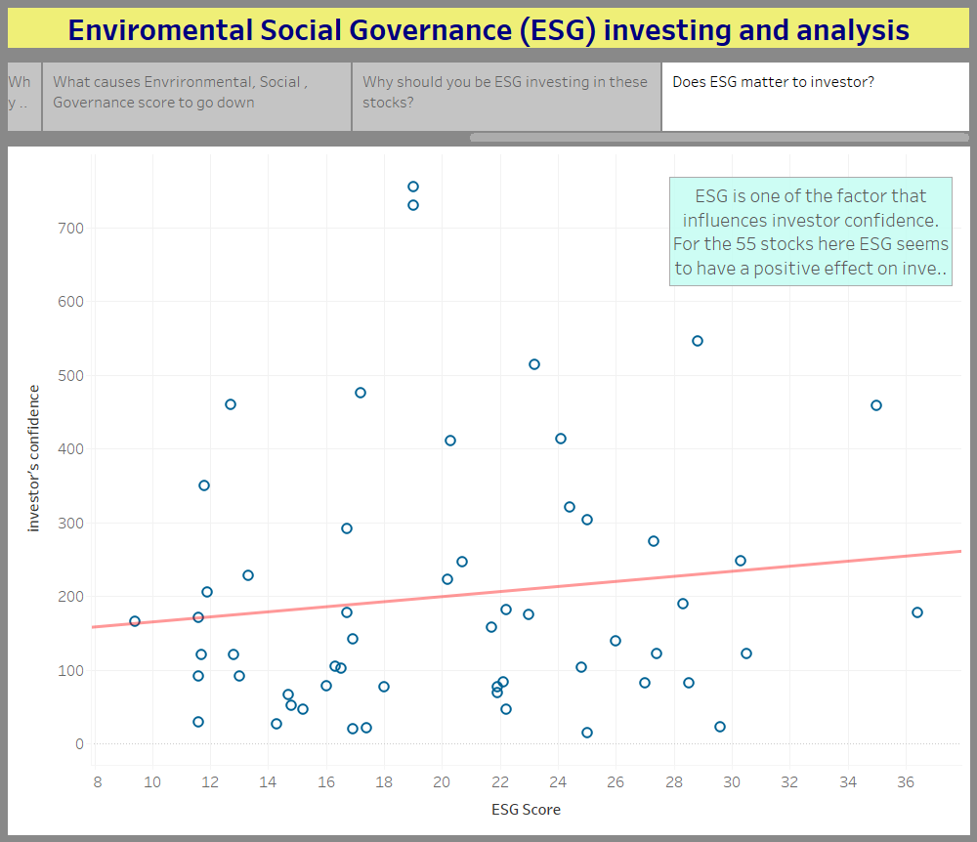

Slide 36
Vision
Future Goals
Week1
Week3
Week2
Week4 & 5
To reduce MAPE on predictions using hyperparameter tuning on each stock.
To checkout ARIMA. LSTM Models for better performance
To update the tables periodically in future as data changes and have a database of historical ESG data.
Data gathering
Database and ML mockup
Fully functioning Database
Fully Functioning ML models -3
First Dashboard and Presentation
3/20/22
4/14/22
3/15/22
3/27/22
6/14/22
Final dataset selection
Database Connectivity
ML first model
Fully functioning Database
Final ML models – 2
ML models integrated in Dashboard/Presentation

Slide 37
References
https://www.investopedia.com/terms/e/environmental-social-and-governance-esg-criteria.asp
https://ca.finance.yahoo.com/
https://www.forbes.com/just-companies/#5d410d762bf0
https://en.wikipedia.org/wiki/Environmental,_social_and_corporate_governance
https://ecyy.medium.com/forecasting-by-fb-prophet-in-colab-c9d4db2d4195
https://www.analyticsvidhya.com/blog/2021/07/stock-prices-analysis-with-python/
https://www.alva-group.com/blog/what-is-an-esg-score-and-how-is-it-calculated/

Slide 38
Team
Monica Dodds
Sachin Nabar
Sucharita B
Yicong Luo

Slide 39
Thank you.

